Slide 1
Laser Cutting

Slide 2
L = Light
A = Amplification
B = By
S = Stimulated
E = Emission
O = Of
R = Radiation

Slide 3
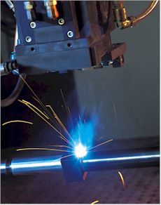
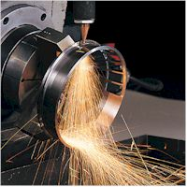
Laser Applications
Daily Applications
Medical Applications
Scientific Applications
Industrial Applications
Military Applications
Special Applications
  Surgery:
    Eyes
    General
    Dentistry
    Dermatology
  Diagnostic Fluorescence
  Soft Laser
  Basic Scientific
  Research
  Spectroscopy
  Nuclear Fusion
  Cooling Atoms
Short Pulses, Study of Fast Processes
  Measurements
  Straight Lines
  Material Processing
  Spectral Analysis
  Laser range-finder
  Target designation
  Laser weapons
  Laser blinding
  Energy Transport
  Laser Gyroscope
  Fiber Lasers
  Compact disk
  Laser printer
  Optical disc drives
  Optical computer
  Bar code scanner
  Holograms against forgery
  Fiber optic communications
  Free space communications
  Laser shows
  Holograms
  Kinetic sculptures

Slide 4
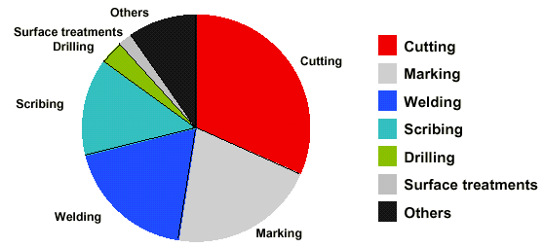
Industrial Laser

Slide 5

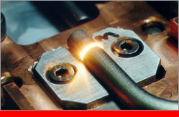
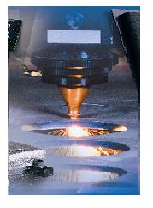
  Cutting
  Welding
  Hardening
  Melting
  Evaporating
  Photolithography
  3-D Laser measurements
  3-D Stereo lithography

Slide 6
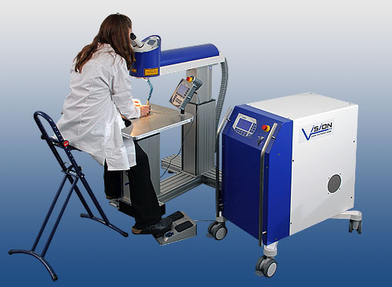

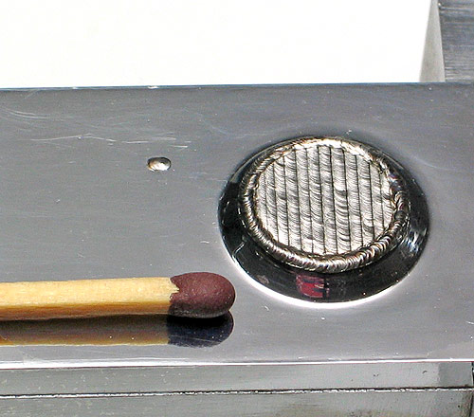
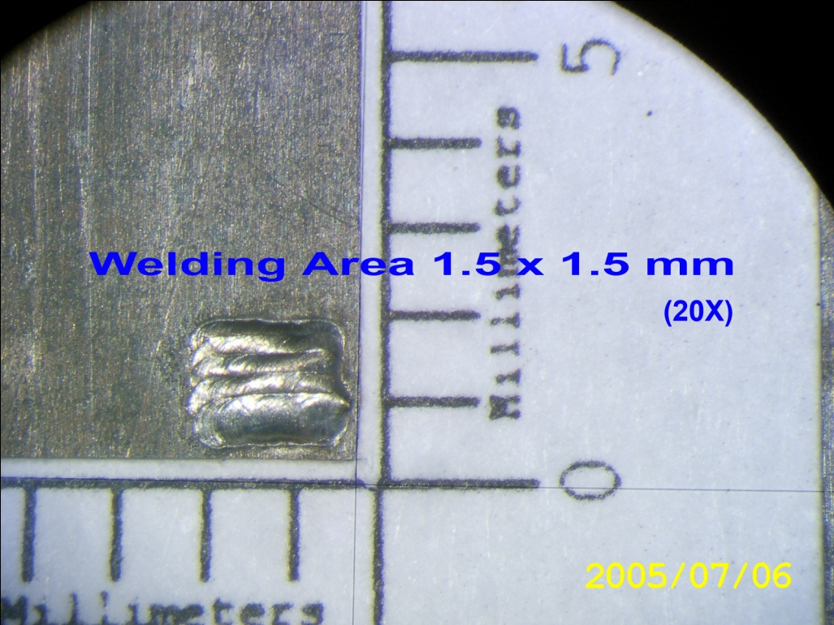

Slide 7

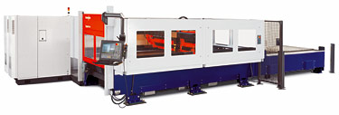
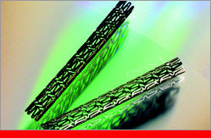
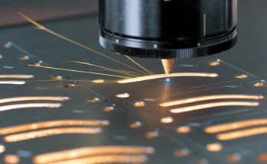
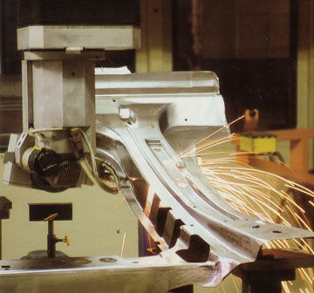

Slide 8
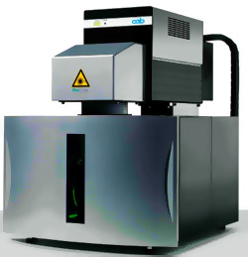

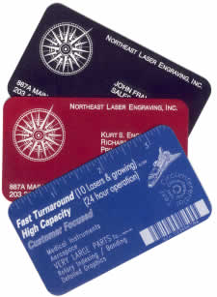
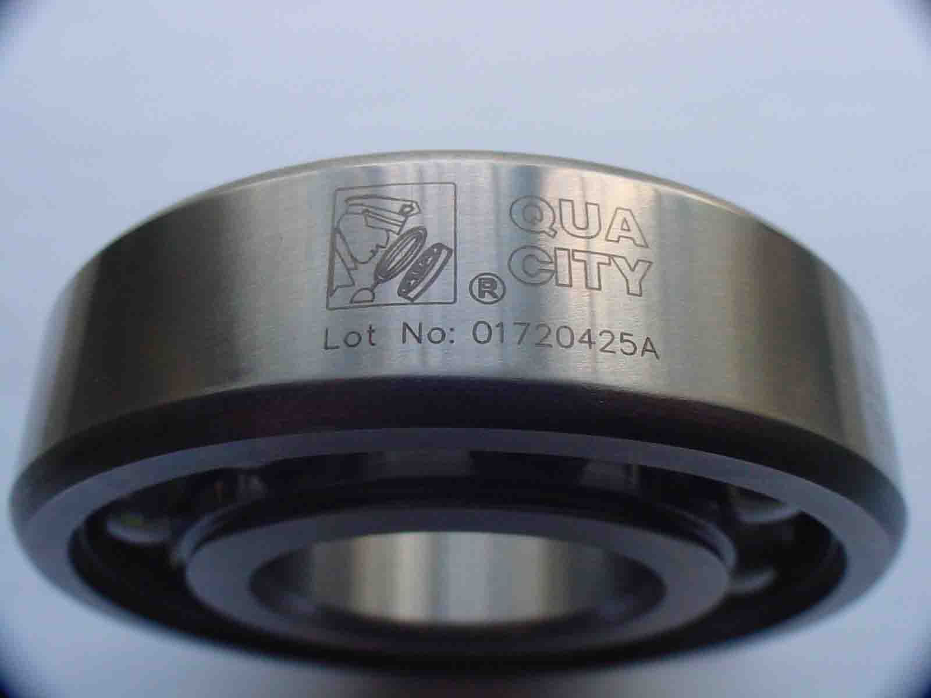
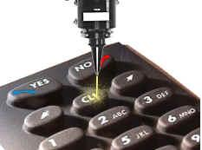

Slide 9
Laser Advantage
Precision (tolerance and surface finish)
  small cut widths (narrow kerfs;0.1mm. for thin material)
  the cut edges are smooth, clean, and square.
  point source, can move in any direction
Productivity (high speed and low cost)
Very low distortion and metallurgical effect.
Automation (CNC, robot etc.)
Most materials can be processed (hard, abrasive, soft, sticky materials)
Quality and reliability

Slide 10
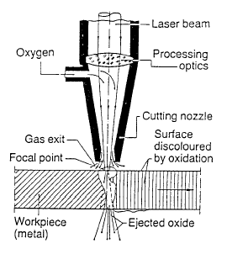
Laser Cutting
When the focused laser beam impinges on the surface of the workpiece, the material partly vaporises.The resulting cutting kerf is surrounded by molten material which is continuously ejected during the cutting process by a stream of cutting gas .

Slide 11
Laser-types
semi-conductor - Laser
solid - Laser
ruby (Al-Oxide doped with Cr) - Laser
"YAG"(Yttrium-Al-Granat) - Laser
gas - Laser
ions (Ar + Kr + only one gas charge) - Laser
molecular (CO2 + N2 + He) - Laser

Slide 12
MMA Welding

Slide 13
WELDING PROCESSES
Fusion Welding Processes
  Arc Welding
  Resistance Welding
  Oxyfuel Gas Welding
Solid State Welding

Slide 14
Two Categories of Welding Processes
Fusion welding
coalescence is accomplished by melting the two parts to be joined, in some cases adding filler metal to the joint
  Examples: arc welding, resistance spot welding, oxyfuel gas welding
Solid state welding
heat and/or pressure are used to achieve coalescence, but no melting of base metals occurs and no filler metal is added
  Examples: forge welding, diffusion welding, friction welding

Slide 15
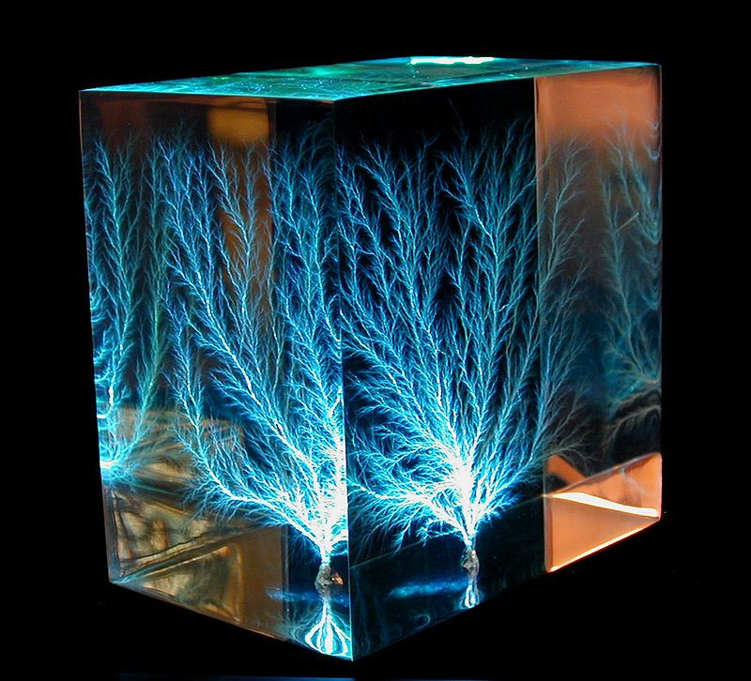

Slide 16
Arc Welding (AW)
A fusion welding process in which coalescence of the metals is achieved by the heat from an electric arc between an electrode and the work
Electric energy from the arc produces temperatures ~ 10,000 F (5500 C), hot enough to melt any metal
Most AW processes add filler metal to increase volume and strength of weld joint

Slide 17
What is an Electric Arc?
An electric arc is a discharge of electric current across a gap in a circuit
It is sustained by an ionized column of gas (plasma) through which the current flows
To initiate the arc in AW, electrode is brought into contact with work and then quickly separated from it by a short distance

Slide 18
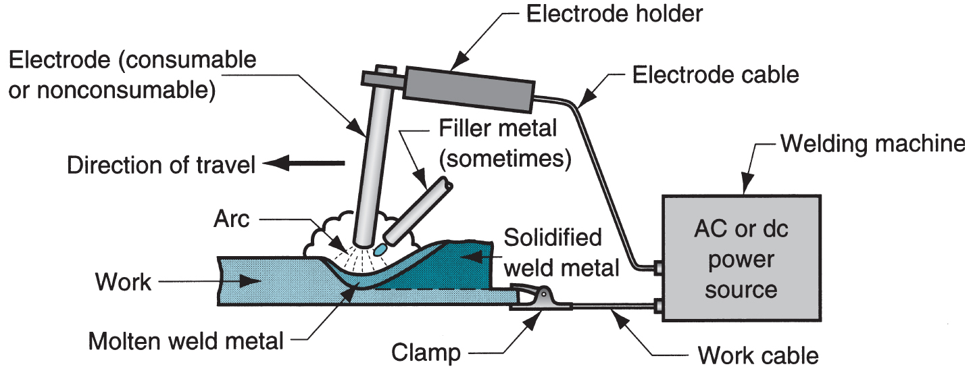
Notes:
Electrode usually coated with flux

Slide 19
Manual Arc Welding and Arc Time
Problems with manual welding:
  Weld joint quality
  Productivity
Arc Time = (time arc is on) divided by (hours worked)
  Also called “arc-on time”
  Manual welding arc time = 20%
  Machine welding arc time ~ 50%

Slide 20
Arc Shielding
At high temperatures in AW, metals are chemically reactive to oxygen, nitrogen, and hydrogen in air
  Mechanical properties of joint can be degraded by these reactions
  To protect operation, arc must be shielded from surrounding air in AW processes
Arc shielding is accomplished by:
  Shielding gases, e.g., argon, helium, CO₂
  Flux

Slide 21
Flux
A substance that prevents formation of oxides and other contaminants in welding, or dissolves them and facilitates removal
Provides protective atmosphere for welding
Stabilizes arc
Reduces spattering

Slide 22
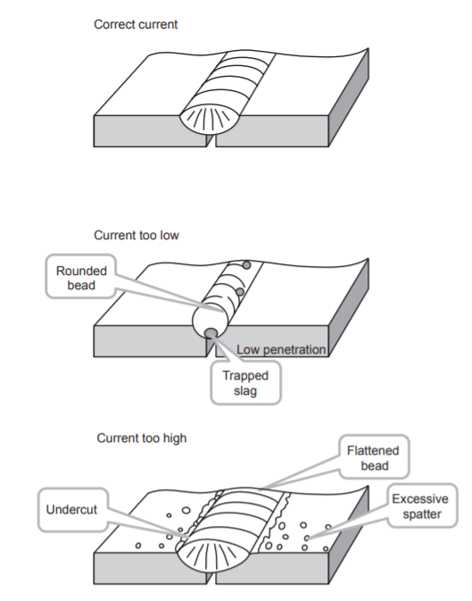
Amperage
Increase in amperage will:
increase the heat of the welding arc
increase fusion and penetration
give a higher deposition rate
increase arc force
enable easier arc starting
give a more fluid weld pool
increase spatter
increase emission of ultra violet radiation

Slide 23
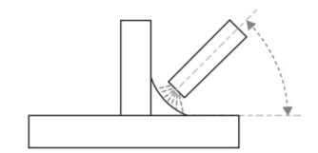
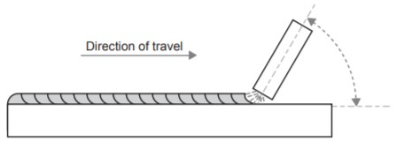
Angles
Angle of Approach
Metal goes were you point the electrode.
  To get an even weld build up, the electrode must be pointed evenly at both plates, ie 45° and the welding arc is ‘directional’, that is metal transfer is essentially along the line of the electrode
Angle of Travel
angle of travel is established essentially as a means of keeping the molten weld pool behind the arc, and preventing the slag from catching up to the electrode and causing slag inclusions.
Commonly set at 60–70°
  Based on amperage, electrode type, and travel speed

